Slide 1
Why Prism+ Should be Rolled Out and How to Make it Successful.
Team Yellow - Mohammad, Beauchamp, Nazmie, Rayan, Charlie & Jude
Notes:
Analysis of Prism’s data over the last 6 months was performed
with the goal to identify the success of Prism+
and whether the loyalty scheme should be rolled out.
We believe this should be continued as there is room for improvement and high potential

Slide 2
Our KPI’s Compared Prism+ Members
to Registered Users
Average Profit per User ->
Prism+ members had a lower average profit per user by £2.48
Conversion Rate of Prism+ -> 0.01-1.62% lower than non-members
Notes:
Focus was on these two key metrics
In terms of profit Bronze tier contribute the least amount of average profit, but customers in the higher tiers only contribute £3 - £6 more
Negative correlation between discount usage and conversion in this 6 month period

Slide 3
Prism+ Has Big Problems But Even Bigger Potential
Wrong Incentives
Established As Successful
Bad Tier Criteria
Money To Be Saved
Prism’s best customers are not after discounts - change the rewards!
Loyalty schemes are very successful for similar e-commerce businesses.
The wrong customers are being targeted with Prism+.
Over 3 years, an estimated £330,000 could be saved by adjusting Prism+.
Notes:
Excessive discounting
Poor member criteria
Transaction count not fair to use
Low profit from Prism+ users

Slide 4
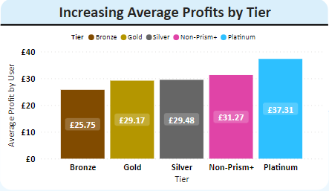
Average Profits by Tier are TOO similar
Slightly increasing average profits but not differentiable enough
Excessive discounting mitigates profits from rising number of transactions
Tier | Avg No. of Transactions
Non-Prism+ | 0.35
Bronze | 1.57
Silver | 3.00
Gold | 4.32
Platinum | 9.09

Slide 5
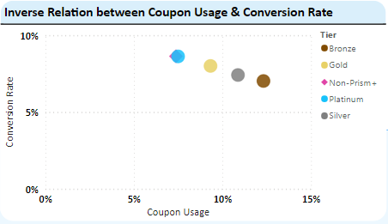
Prism’s Best Customers Do Not Want Discounts
Notes:
Dashboard

Slide 6
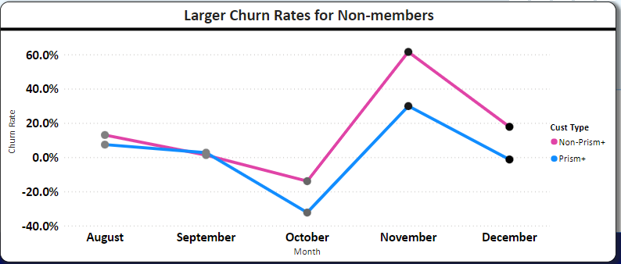
Churn Rate is Lower For Prism+ Members

Slide 7
Fashion E-Commerce Loyalty Schemes WORK
Customer retention (80% more likely) & increase CLV
Increase brand value & build loyal community
Customer acquisition 5x - 25x more expensive than retention
Access to detailed customer data to enable personalised marketing (90% more appealing)
Notes:
Here are some key advantages above and in addition to this
Over 80% of consumers say loyalty programs make them more likely to continue doing business with a company.
Around 80% of Gen Z consumers increase the frequency they buy from a brand when they are part of that company’s loyalty program, with 76% of Gen X customers and 53% of baby boomers.

Slide 8
Prism+
Revamped!
A step towards a new loyalty scheme.
Notes:
Our argument is that the loyalty programme should be continued
As research has shown how successful these schemes are for similar e-commerce companies.
In addition, solutions have been provided to address the problems identified earlier,
With further actionable recommendations prescribed to ensure Prism+ has a successful rollout and continued long-term success.

Slide 9
Tiers Should Be Based On 6 Month Purchase History
Platinum
Gold
Silver
Bronze
Level | Top 30% | Top 10% | Top 3% | Top 1%
Criteria | Spend £20 - £39.99 | Spend £40 - £59.99 | Spend £60 - £99.99 | Spend £100+
Benefit | Free Next Day Delivery | 5% off £40+ | 7.5% off £60+ Prism Flask | 10% £100+ Pre-Sale Access Early Access Personalised Gift
Notes:
Apply perks to Bronze (free next-day delivery), Silver (Bronze benefit + 5% off £50+), Gold (Bronze & Silver benefit, 7.5% off £50+ and one-time Prism Flask) and Platinum (Bronze, Silver, Gold benefits +10% off £100+, early access to exclusive products and personalised gift).

Slide 10
More KPIs Could Lead To Better Tier Criteria
UPT
AOV
CLV
Profit / ROI
over time
You can replace the image on the screen with your own work. Just right-click on it and select “Replace image”

Slide 11
Our Proposals Will Create Between £110k-550k Profit
Offer New Incentives
Modify Tier Criteria
Experiment With A/B Tests
Notes:
Redefined tier boundaries
Controlled discounting & special perks
Assess scheme over 6 months of rewards then then experiment with A/B testing on benefits

Slide 12
Thanks!
Do you have any questions?

Slide 13
Appendix
Our workings:- https://rb.gy/l0edq
Our dashboard:- https://rb.gy/c5dbz
Our research:- https://rb.gy/99x96

